Slide 1




Toolkit
Last updated Jul 2026 by Alex Clare-Young

Slide 2






Welcome to CAN. This resource takes you through ways your church can continue on your CAN journey. Contents:
CAN film
Agreement
How to...
6 Hopes
Building a relationship with your MP
Extra resources

Slide 3


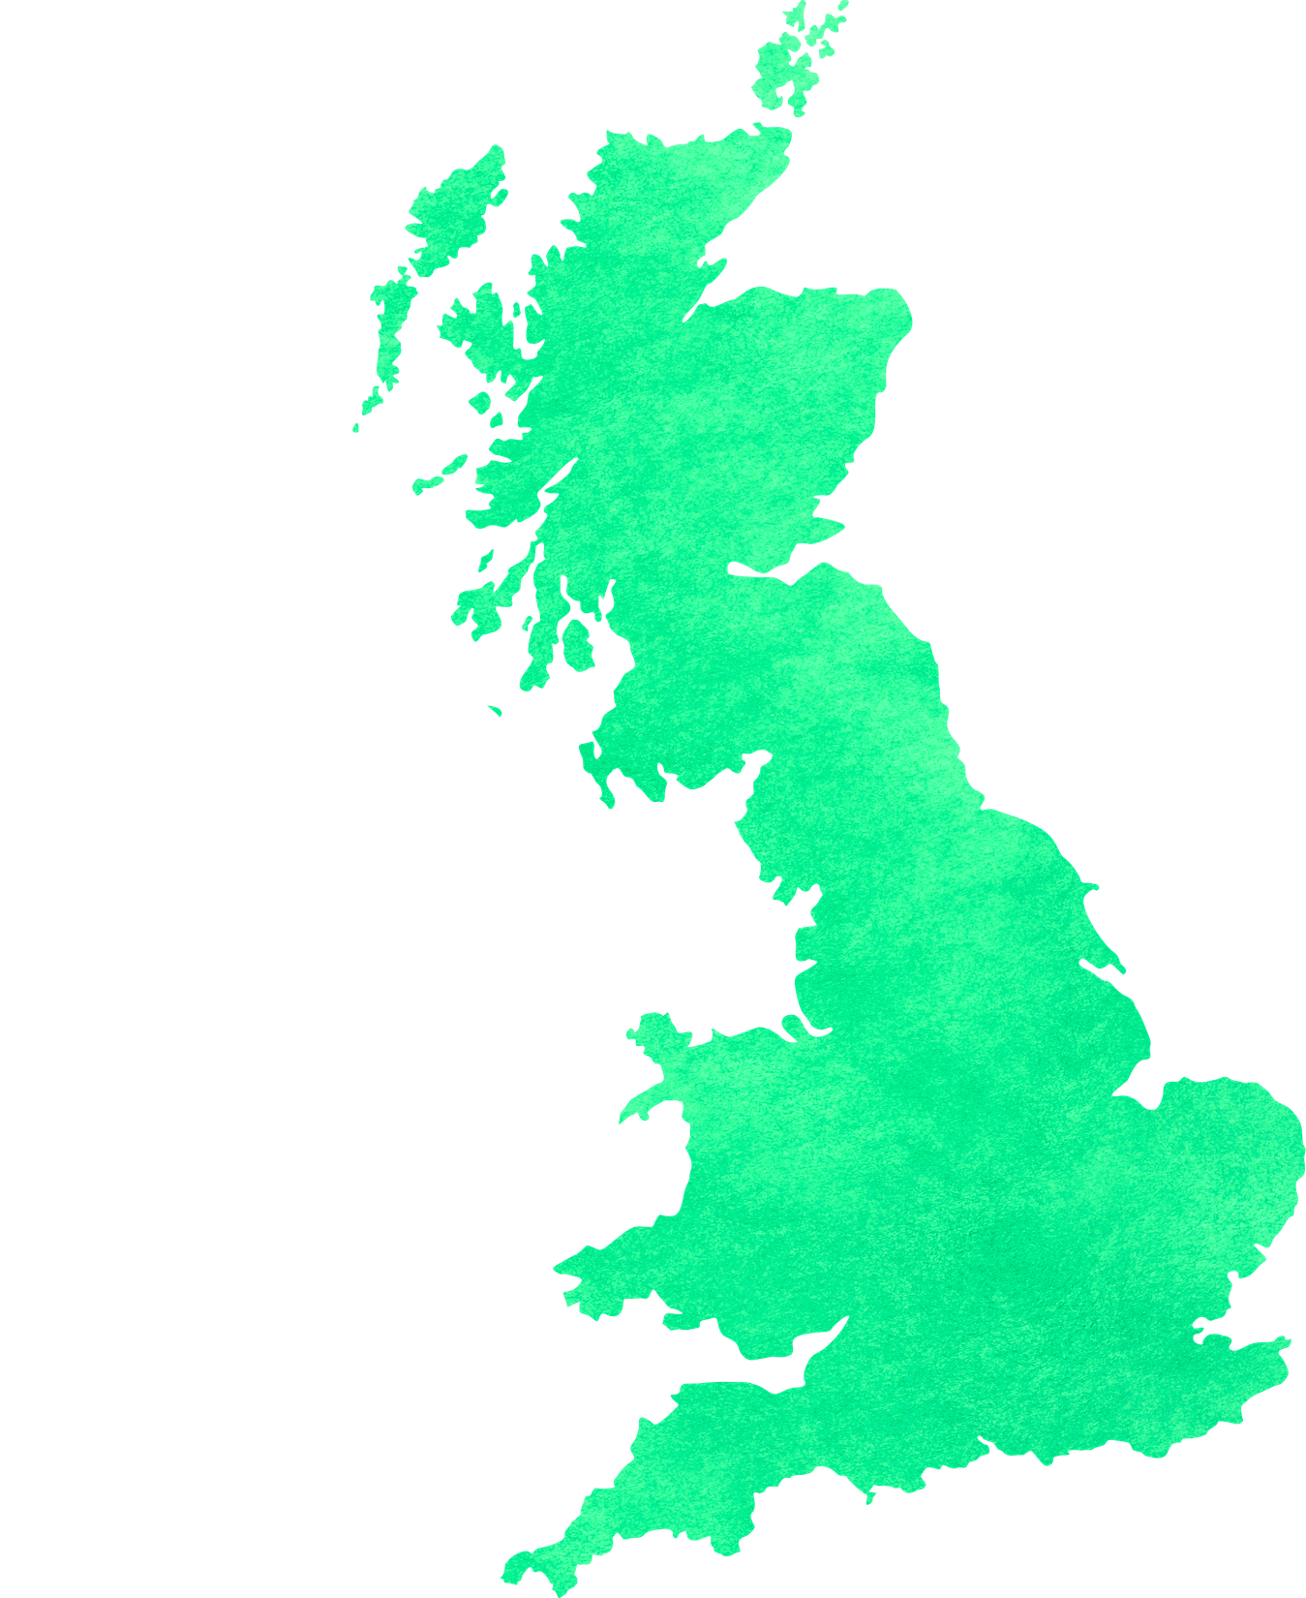

JPIT’s Constituency Action Network (CAN) is a network of churches across the UK who are committed to building meaningful relationships with their MP and working with them to speak and act for peace and justice.
CAN is not about giving churches lots more work to do, it is about supporting each-other and building a network to strengthen the work that is already going on. Our goal is to establish a network of at least one church or equivalent in every constituency in England, Scotland and Wales.

Slide 4
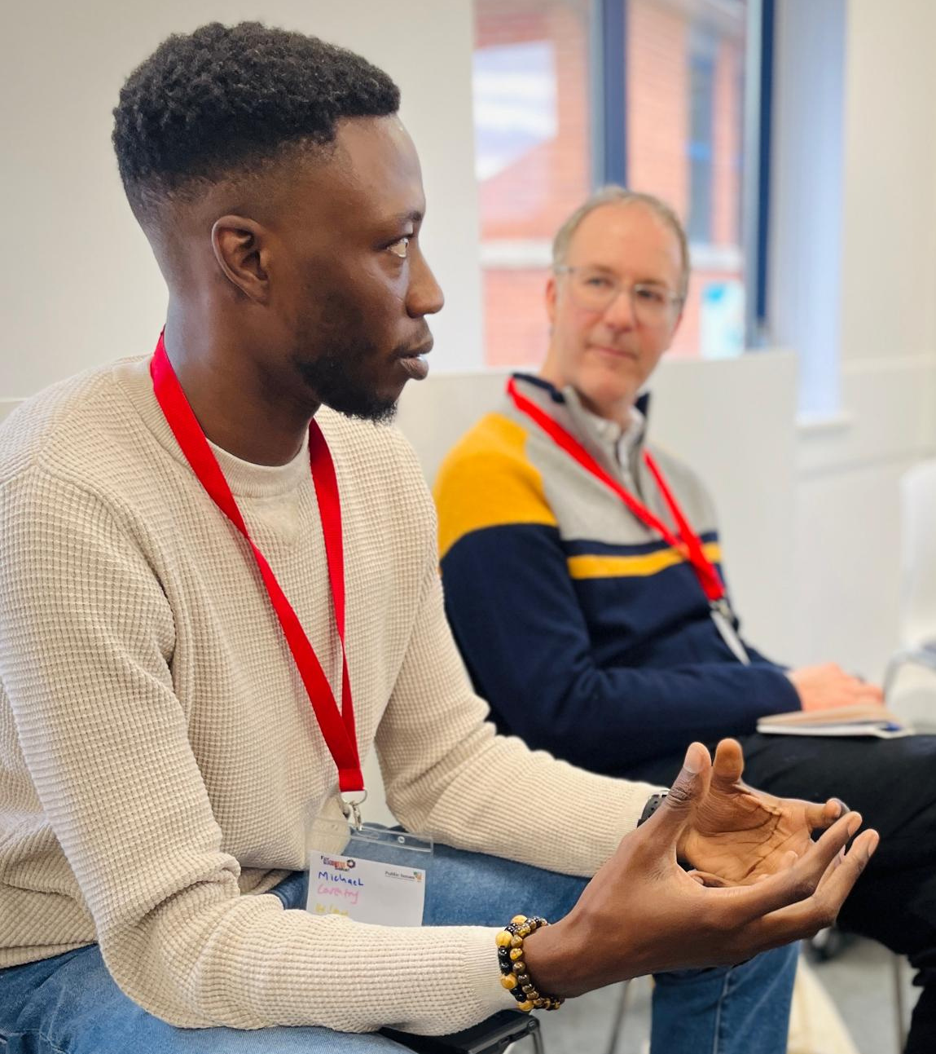
Agreement
When you joined CAN, your church and JPIT made an agreement with each other. The following pages outline the responsibilities involved in being a part of CAN, and what you can expect from JPIT.

Slide 5



Your church agrees to:
Relationship
Pray
Listen
Build a positive and purposeful relationship with your MP
Intentionally sustain that relationship and pray for your
MP regularly
Listen to one another, within the church, to the wider community and to your MP about local and national concerns

Slide 6


Your church agrees to:
Contact
Engage
Maintain contact with JPIT, feeding back our listening and enabling representatives to attend training and other gatherings
Engage with campaigns that are promoted by JPIT and our denominations as appropriate to address issues of peace and justice

Slide 7



JPIT agrees to:
Resource
Awareness
Build
Resource CAN churches with advice and ideas to help you build and sustain positive and purposeful relationships with
your MPs
Provide resources to make CAN churches aware of issues being considered in parliament and concerns that they raise
Continue to build the national network to ensure the impact of CAN is advanced

Slide 8


JPIT agrees to:
Pray
Listen
Pray for churches and their MPs on a regular basis
Listen to CAN churches and be attentive to and informed by the local and national issues that matter to them

Slide 9

How to guides
Do you feel like you just need some help to get started? These resources have been designed to offer just that.
Perhaps you’ve signed up to CAN but your church is a little lukewarm. If so, read our guide to engaging your church in CAN.
Have you been in touch with your MP yet? If not, our guides can help you to make those first moves towards writing to or meeting your MP.
Worried that you and your MP are just too different? Or perhaps your church is struggling to find political common ground? Fear not – our final two guides introduce some practical tips to help.

Slide 10
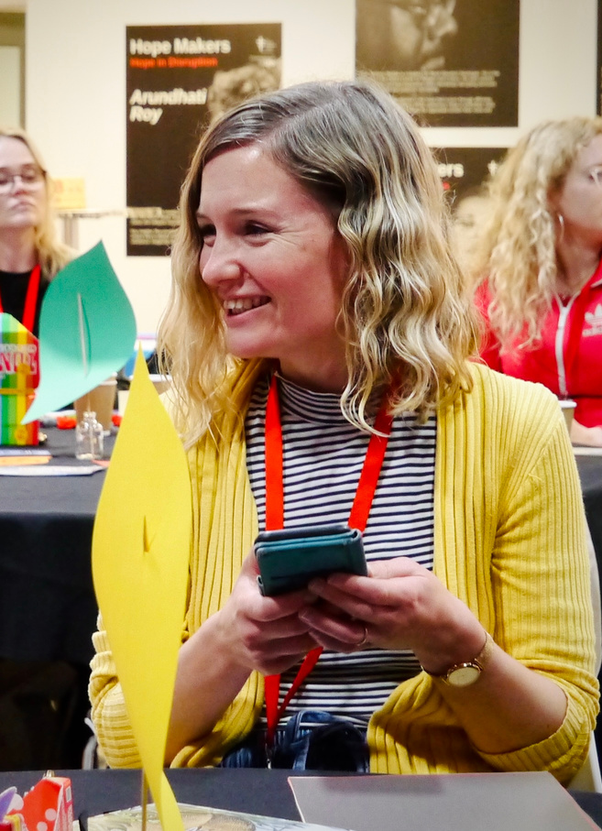

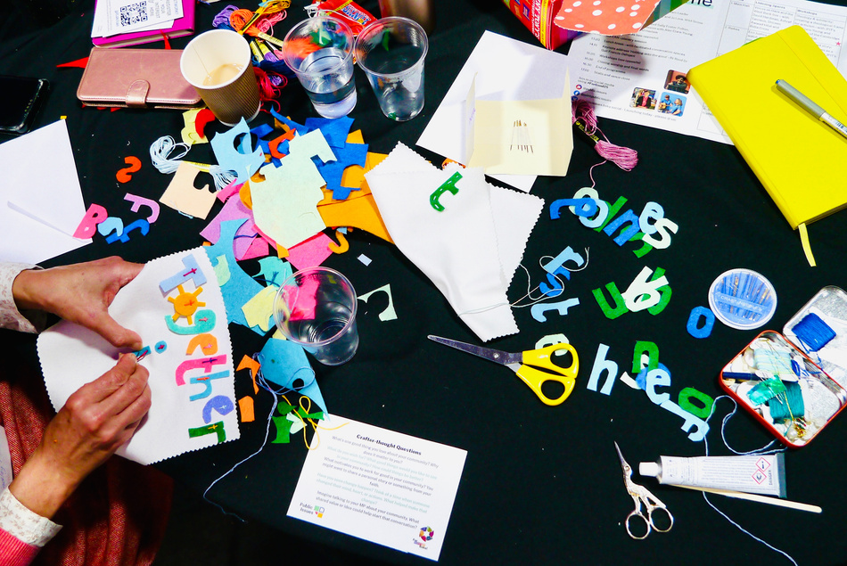
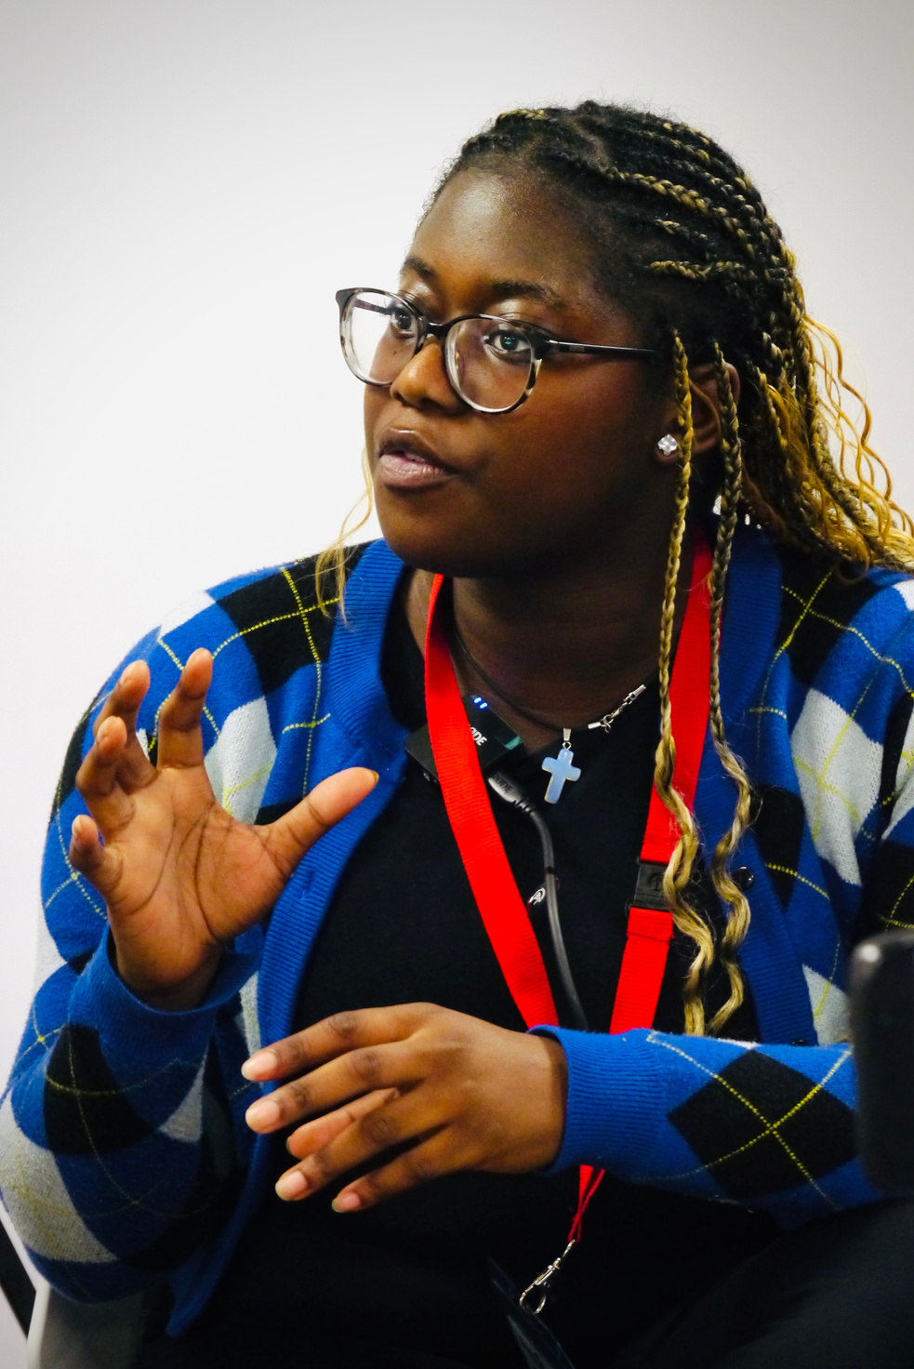
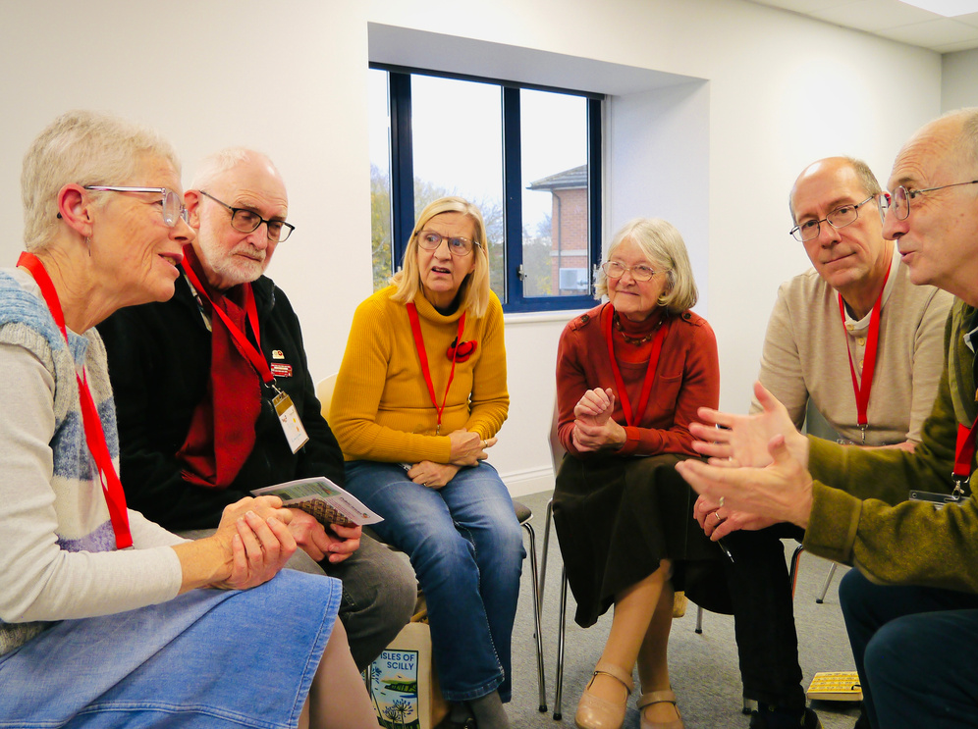
How to Engage your Church in CAN
Have a CAN Sunday: Use the resources at the end of this document to shape worship around acting for peace and justice in your constituency. Consider having a church lunch afterwards, where you can discuss the Constituency Action Network.
Show the CAN film in your church. You can find it at the top of this document.
Consider setting up a CAN group in your church: that group can steer your engagement with the network and work to enable the whole congregation to join in your campaigning.
Link CAN into things that you are already doing.
  Do you run a foodbank? Perhaps straight after it closes is the time to think about how you might reach out to your MP around poverty.
  Do you have a craft session, such as knit and natter? Perhaps you could consider doing some craftivism once a quarter and creating something to send to your MP or display in your church.
  Do you have a prayer group? Perhaps you could also hold your MP in prayer.

Slide 11

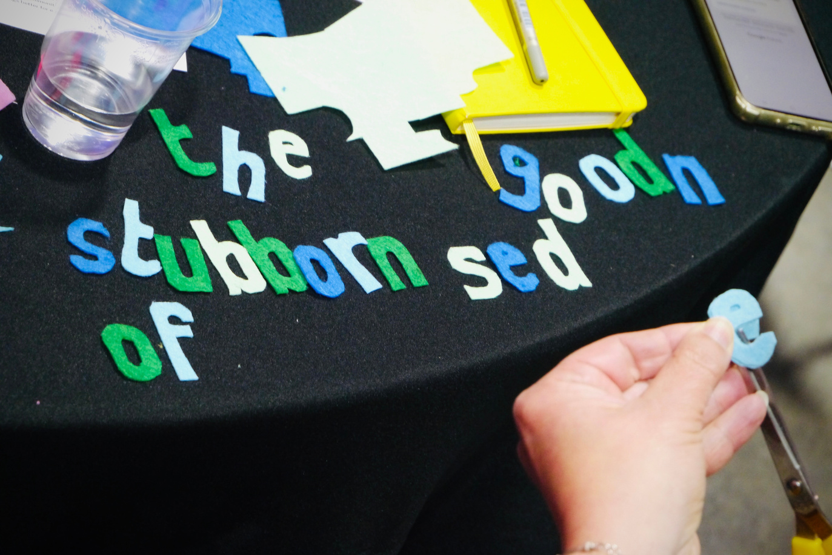
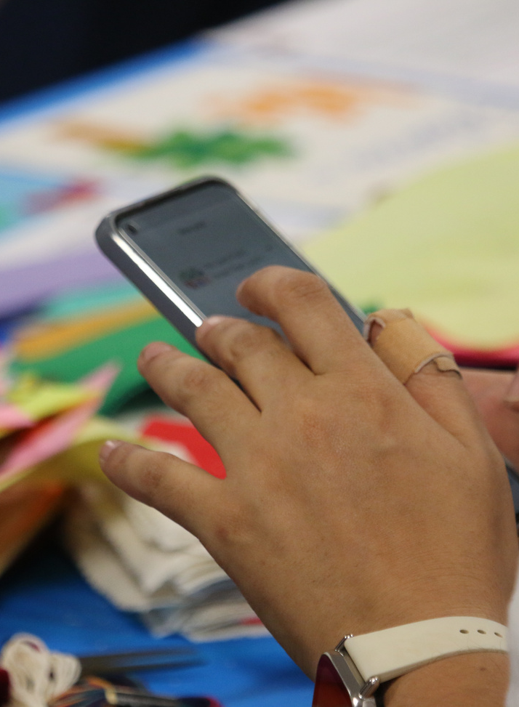

How to write to your MP
A personal letter or postcard to an MP is incredibly valuable. It is really important to write your own letter to your MP. Whilst templates can be helpful, if MPs’ offices receive lots of copies of the same letter – particularly if it comes via email – they are less likely to be treated as important.
Here are some top tips:
  You can write to your MP about any topic you care about. However, it can be useful to check whether it is something an MP can help with, or if it is something that should be discussed with your local council or the organisation responsible.
  Personal stories help – connect the issue you are writing about to your own story or a story you know about. It can help to witness to the human beings behind every issue.
  Make a clear, realistic ask. What do you want your MP to do, or to speak out about?
  Find out who your MP is and how to contact them here.

Slide 12
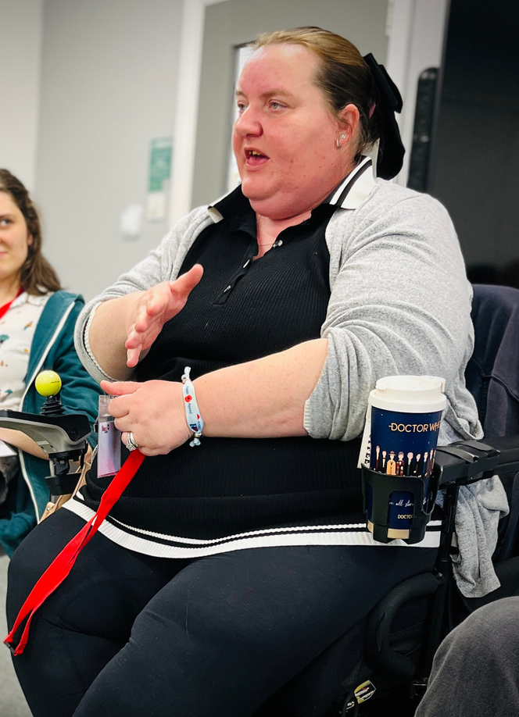
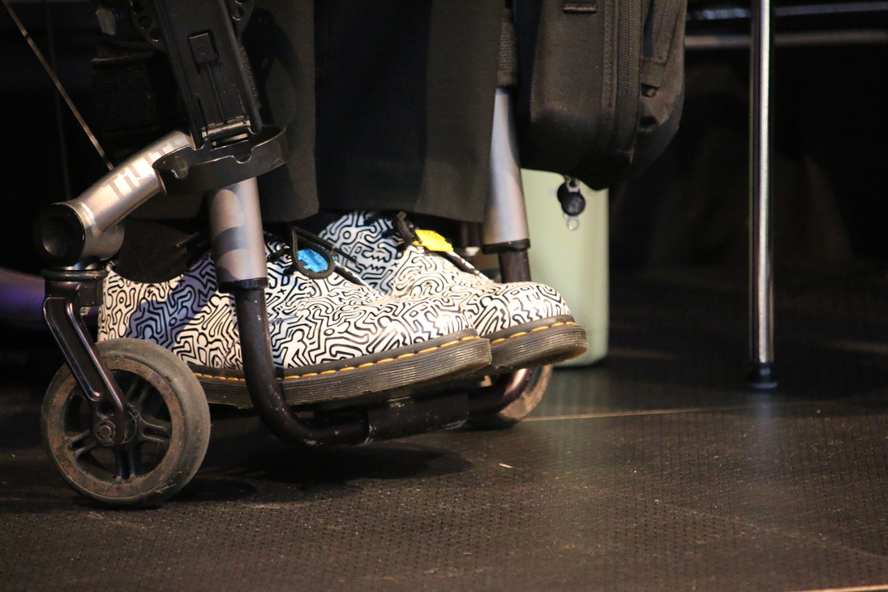
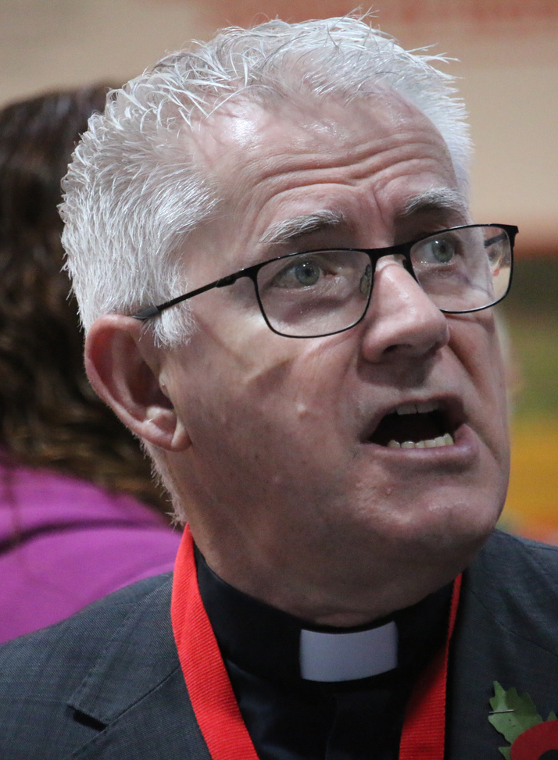

How to meet your MP
Have you ever been to your MP’s surgery (that’s the regular sessions they hold for people from their constituency to meet with them)? Has your MP ever been to your church? Why not meet your MP?
When you write to your MP, you can ask when their surgery is. That way, you can follow up with a face-to-face conversation. This approach means that they have time to consider the issue that you have written to them about, and you can then reenforce your message, and hear what they think, by meeting with them face-to-face.
We would also love churches, or groups of people from churches, to meet with your MP. This doesn’t need to be onerous or relate to a specific campaign. It’s about having an opportunity to get to know them.
Find ideas about events you could invite your MP to later in this resource.
Find advice on hustings – public meetings held with candidates before an election – on our hustings page.

Slide 13
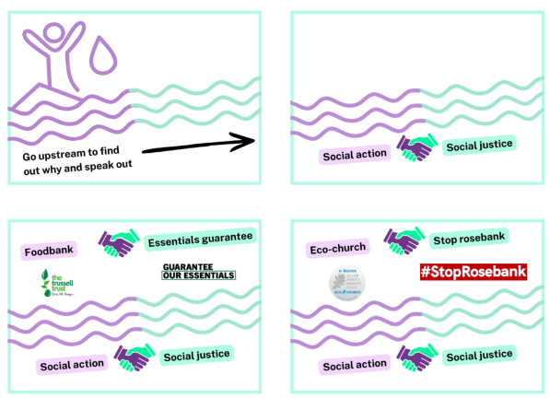
How to find a shared issue
Sometimes, it is hard for churches to find common ground to campaign on. Or perhaps there are so many public issues that it is hard to know where to start. Our CAN church video tells the story of going ‘up the road’ to connect social justice to social action.
Another way of thinking about this is the well-known quote often attributed to Desmond Tutu, “There comes a point where we need to stop just pulling people out of the river.
We need to go upstream
and find out why they’re
falling in.”

Slide 14
Now, we are not telling you to stop doing social action – it matters – but encouraging you to connect your social action to social justice. Connect the things that your church is already doing to public issues that you could campaign on or speak to your MP about.
  Does your church run a foodbank? Perhaps you could speak to your MP about guaranteeing essentials within universal credit.
  Is your church an eco-church? Perhaps you could speak to your MP about stopping Rosebank oil field.
By social action, we mean anything your church is doing to help your community thrive, from food banks to debt support to
youth groups and
supporting refugees.
Whatever your church is or
does, there is always a way
to connect who you are, and
what you do, to major issues
that politicians are making
decisions about. If you aren’t
sure, reach out to us
for ideas.

Slide 15
How to have dialogue across difference
“Blessed are the peacemakers” (Matthew 5:9)
Sometimes, difficulties and disagreements may emerge in conversations about public issues.
The Church of Scotland offers the following advice for dealing with conflict:
  Be aware of differing perspectives
  Be aware of our own “baggage”
  Be aware of the need to listen more than to speak
  Be aware of the need to find common ground
  Be aware of the need for face-to-face dialogue
  Be aware of the need to forgive
You can find more support and training on conflict management through Place for Hope, who offer training and facilitation for the Methodist Church and the URC.

Slide 16






JPIT’s 6 hopes
The Joint Public Issues Team has 6 hopes for society:
Economy
Poverty & Marginalisation
A just economy that enables the flourishing of all life
A society where the poorest and most marginalised are at the centre
Peace
Environment
A world that actively
works for peace
A planet where our environment
is renewed
Refugees
Politics
A society that welcomes
the stranger
A politics characterised by listening, kindness
and truthfulness

Slide 17
Building a relationship with your MP
Top tips
Make it personal
Invite them to see
Be a critical friend
An MP's office receives hundreds of identical emails a week - these are often just tallied and filed. A short, handwritten card or a personal email explaining why an issue matters to you or your local community is significantly more likely to reach the MP's desk and stay in their mind.
Don't just tell your MP about a problem; show them the community's heart. Invite them to a church coffee morning, a social justice project, or a community lunch. Seeing your church's work in action builds a bridge that a letter alone never could.
You don't have to agree with your MP on everything to have a relationship. Start by thanking them for a specific piece of work or letting them know you are praying for them. When you do have a difficult ask or a concern, they will be much more likely to listen to someone who has already shown them respect and kindness.

Slide 18

Did you know...
Research shows that only 10-15% of constituents ever contact their MP. When a church reaches out, it isn't just one voice - it is a rare, trusted, community voice that stands out.
- Professor Philip Norton, cited in IPSA's 'What's Democracy Worth?' research series

Slide 19

Faith groups are known & trusted by their communities. No other networks can match the presence of faith communities.
- Sir Stephen Timms MP,
September 2024

Slide 20
Extra resources
  The Art of the Possible - A small group study resource exploring what our faith has to say about politics. Ideal for use in a home group or church course before taking action together.
  Justice Weekly - JPIT's weekly briefing on justice issues and what's happening in Parliament. A great way to stay informed about the issues your MP is debating.
  Christian Aid: Breaking Bread Guide - A downloadable guide to inviting your MP or local councillor into your church community to share a meal and talk about justice issues. Simple, relational, and effective.
  Find Your MP - UK Parliament - The official tool. Enter your postcode to find your MP's name, email address, and Westminster address in seconds.
  Scottish Churches Parliamentary Office (Scotland only) - A Scotland-specific toolkit and set of ideas for engaging with your MSP and MP, produced by the ecumenical churches' parliamentary body in Scotland.

Slide 21


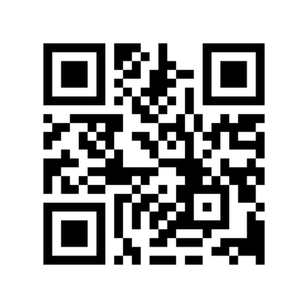
Thank You!

